Slide 1
Hover Hero
Alexander Epple, Felix Kosian, Musfira Naqvi

Slide 2
Overview
Third person endless runner
Hovering above the ground instead of running
Vertical and horizontal gameplay
Video Game/Movie references as “setting”
Underground as environment

Slide 3
Design
Superhero concept
Films & games as inspiration, eg.:
Hoverboard (Back to the Future)
Hadouken (Streetfighter)
Coins & Fire flower (Super Mario)
...
Various underground biomes:
Crystal mine
Maya dungeon
Lava cave
Different enemies

Slide 4
Features - Planned
Must have:
Avoiding obstacles
Procedural level-generation
Gesture recognition
Fighting enemies
Nice to have:
Multiplayer
Powerups
(High)Score / Collectables
Additional environments
Multiple pathways

Slide 5
Features - Result
Implemented:
Avoiding obstacles
Procedural level-generation
Gesture recognition
Fighting enemies
Powerups (Items)
(High)Score / Collectables
Additional environments
Sounds
Ingame settings
Omitted:
Multiplayer
Multiple pathways

Slide 6
Distribution of tasks
Felix: World Generation, Game Mechanics, Player Movement (World)
Alex: Kinect Integration, Game Mechanics, Player Movement (Kinect)
Musfira: Character Modeling, Game UI, Highscore and Main Menu

Slide 7
Special Focus: World Generation (5 Steps)
Step 1: Biome selection
Step 5.1: Enemies
Step 5.2: Items
Step 2: Element selection
(Step 2 1/2: Stone Generation)
Step 3.1: Decoration
Step 3.2: Obstacles
Dynamic generation: all selections, randomizations and spawning at runtime
Step 4.1: Details
Step 4.2: Details
Final Result

Slide 8
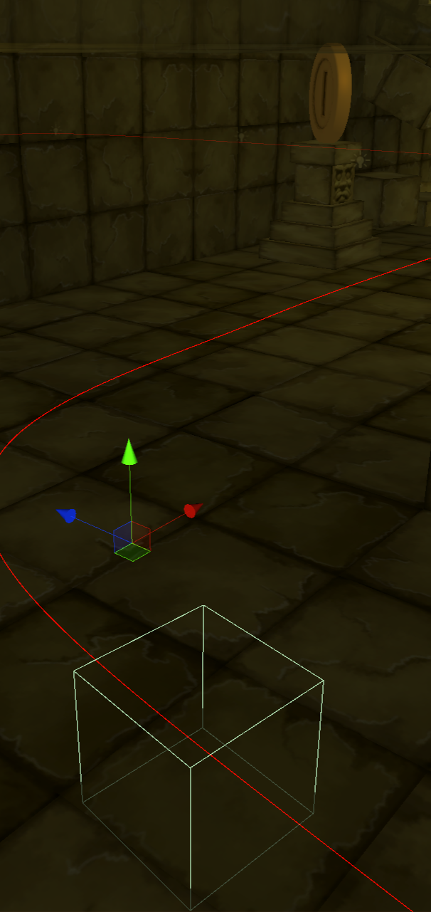
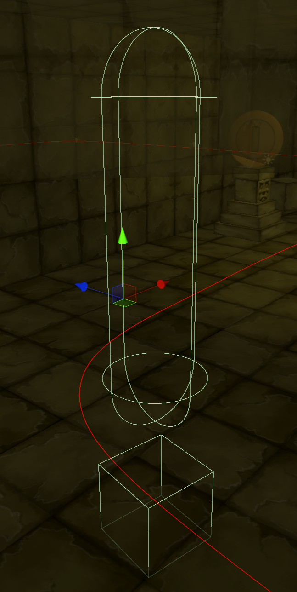
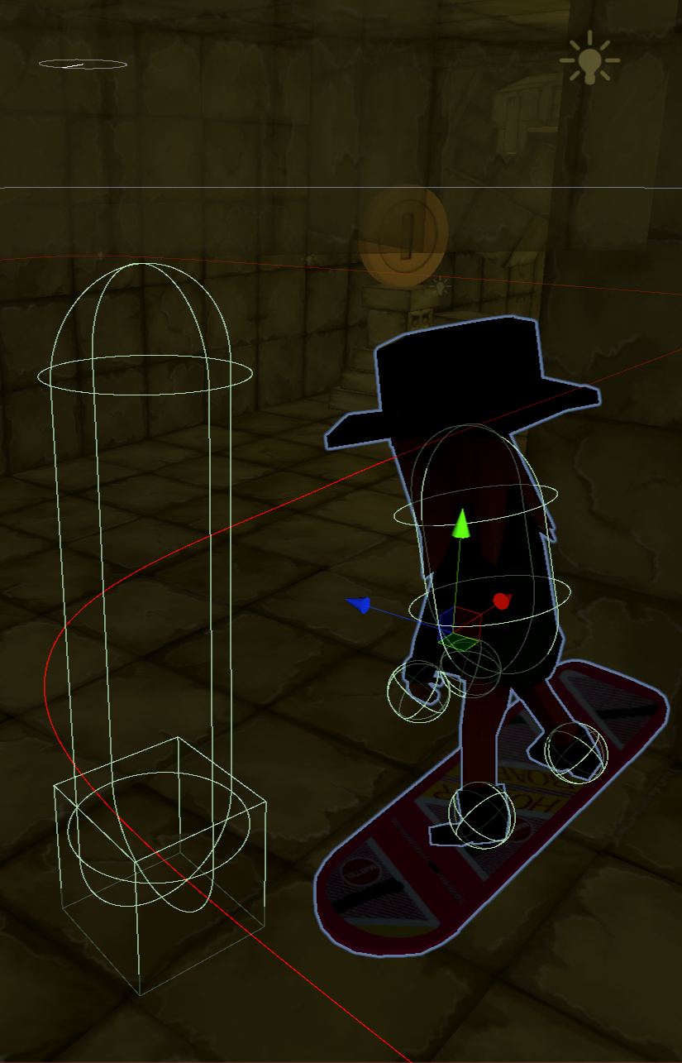
Special Focus: PLayer Movement
3 Layer Character:
First Layer: Following world spline
Second Layer: Physics based jumping
Third Layer: Movement in Kinect space & body collision detection
Layer 1
Layer 2
Layer 3

Slide 9
Special Focus: Complex Gestures
Shield:
Cross hands close to body
Gesture ends when no longer detected (with a small delay)
Jump & Crouch:
Track positions of hip and feet
Detect movement up/downwards
Detect feet on/off ground
Hadouken:
Charge by holding hands close together close to body
Fire by pushing them in a direction away from body
Direction of shot is calculated after hands stop moving
Fire Throw:
Detect hand next to shoulder
Fire by moving hand away
Direction of shot is calculated after hand stops moving

Slide 10
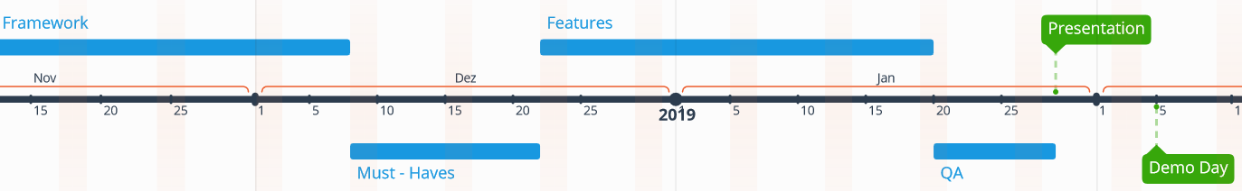
Timeplan - Milestones
08.12.18 - First “playable” version (proof of concept)
22.12.18 - Finished all Must-Haves, starting Nice-To-Haves
20.01.19 - Feature freeze, only Bug-Fixing & Testing
29.01.19 - Presentation
05.02.19 - Demoday

Slide 11
POStmortem…: What did we learn?
Fail Faster (with Unity)
Don’t lose your focus on what is really necessary
Ending up with a game you have fun playing is always satisfying
Learning new stuff can be frustrating but don’t give up!

